Slide 1
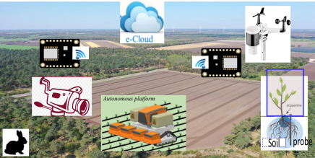
Cloud computing for agriculture
Matteo Francia
2023-07-10

Slide 2

whoami
Matteo Francia, Ph.D.
Email: m.francia@unibo.it
Assistant professor (junior) @ DISI --- UniBO
Teacher of “Big Data and Cloud Platforms”
Research topics
Big data / database / business intelligence
Precision agriculture and spatio-temporal analytics
BIG (Business Intelligence Group)
https://big.csr.unibo.it/
Thanks to E. Gallinucci, M. Golfarelli, S. Rizzi, J. Giovanelli, C. Forresi for the shared effort and materials
Data Platforms
& Analytics
Social BI
Big Data
DW optimization
Data Mining
DW Design

Slide 3
Background

Slide 4
How did we get here?
Data-Driven Innovation
Use of data and analytics to foster new products, processes and markets
Drive discovery and execution of innovation, achieving new services with a business value
Analytics
A catch-all term for different business intelligence (BI)- and application-related initiatives
E.g., of analyzing information from a particular domain
E.g., applying BI capabilities to a specific content area (e.g., sales, service, supply chain)
Advanced Analytics
(Semi-)Autonomous examination of data to discover deeper insights, make predictions, or generate recommendations (e.g., through data/text mining and machine learning)
Augmented Analytics
Use of technologies such as machine learning and AI to assist with data preparation, insight generation and insight explanation to augment how people explore and analyze data

Slide 5
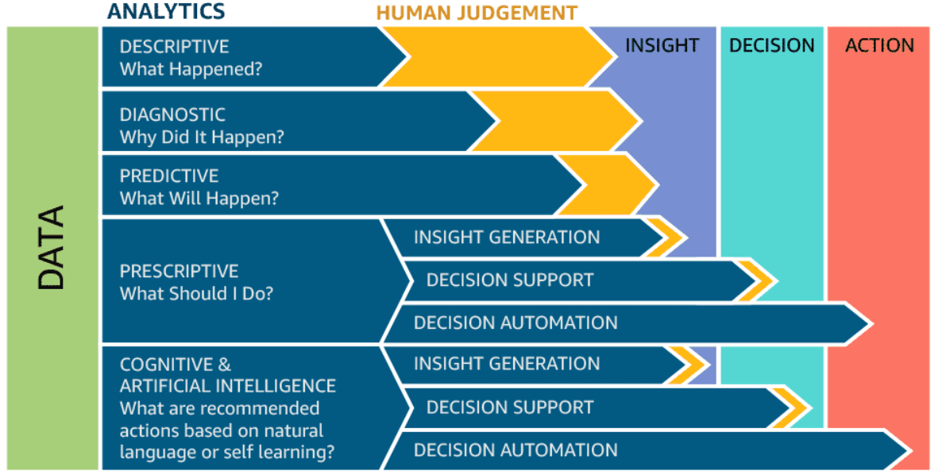
How did we get here?

Slide 6
Why going cloud?
Digitalization is a journey that involves three main dimensions
Moving from A to B is a multi-year process made of intermediate goals
Each of which must be feasible
Solves a company pain and brings value
Can be accomplished in a limited time range (typically less than one year)
Costs must be economically related to gains
Are processes extensively digitalized and produces reliable data?
Technological infrastructure
B
Do we have the right persons to drive the project and exploit the results?
Data quality
& quantity
Is the technogical infrastructure appropriate to support data collection and analysis?
A
Digital culture

Slide 7
Big data as a noun – The V’s
The big-data cube
Volume: small to big
Variety: structure to unstructured
Velocity: pull to push
Small
Volume
Structured
Big
Variety
(data model)
Batch
Stream
Unstructured
High
Velocity
Low
(pull)
(
(
push
latency
)
)

Slide 8
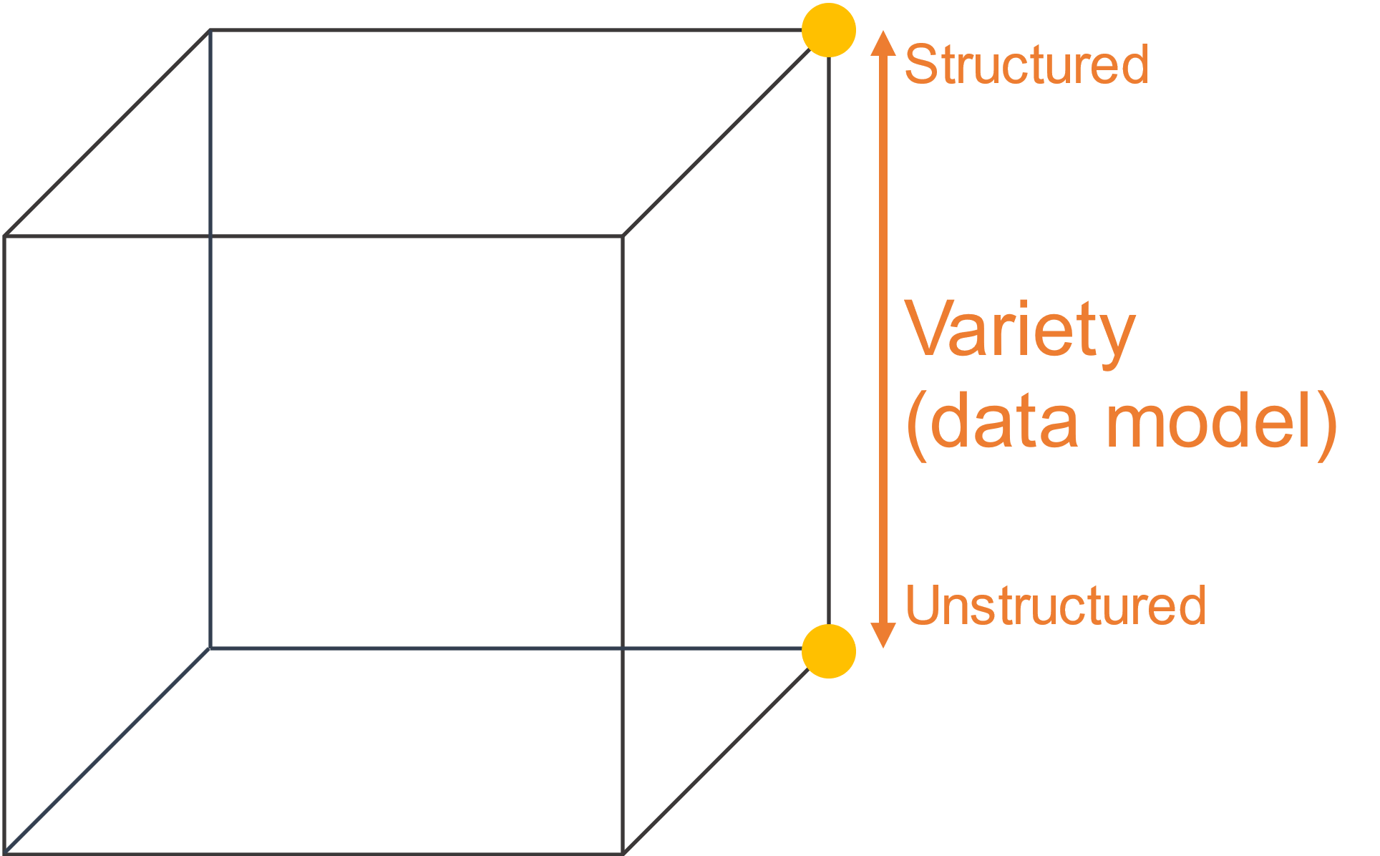
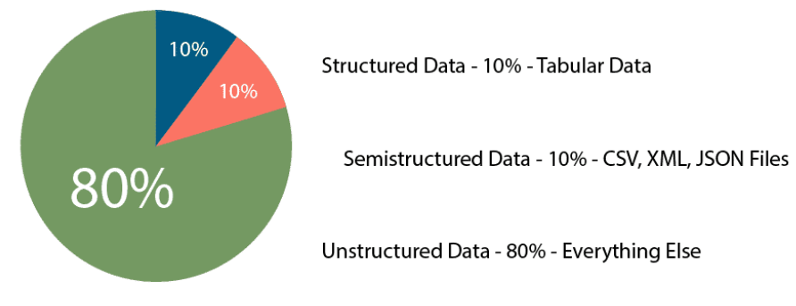
Reference scenario
Variety
Structured
Relational tuples with FK/PK relationships
Unstructured
Key-value
Columnar
Document-based
Graph
...

Slide 9
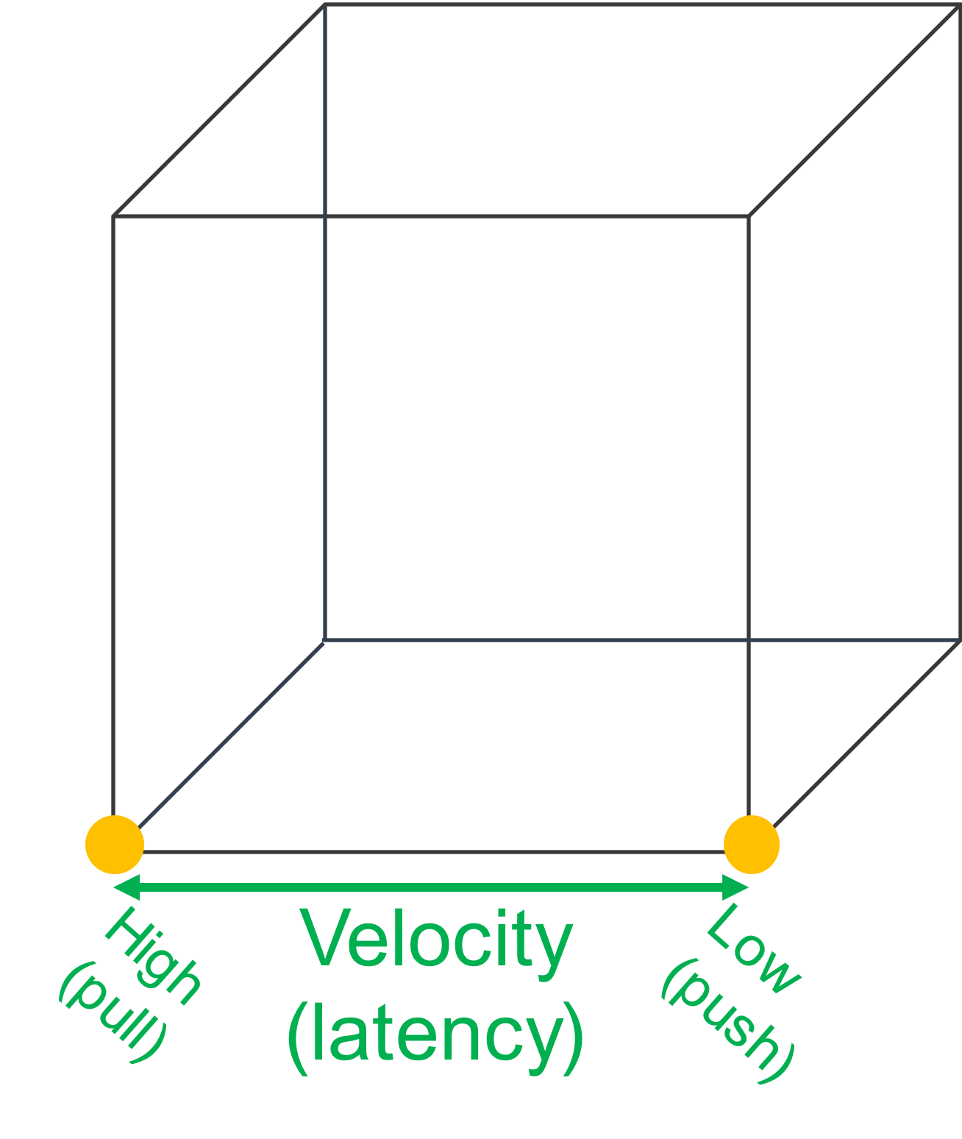
Reference scenario
Velocity (latency)
High: clients synchronously pulling data from sources
Low: sources asynchronously pushing data to clients
Velocity (speed; dual to latency)
High: processing in real-time (milliseconds) or near-real time (minutes)
Low: processing can take hours
Acceleration
Velocity is not constant, data comes in bursts
Take Twitter as an example
Hashtags can become hugely popular and appear hundreds of times in just seconds
… or slow down to one tag an hour
Your system must be able to efficiently handle the peak as well as the lows

Slide 10
Cloud Computing

Slide 11
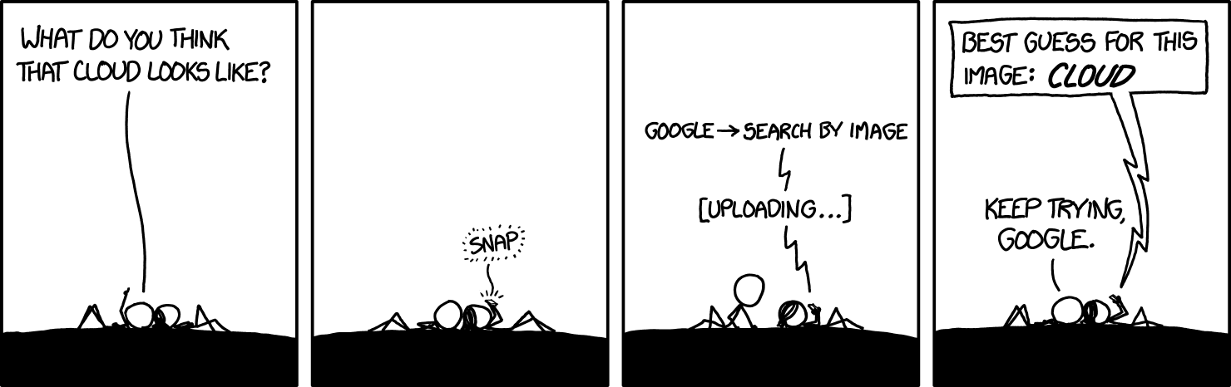
https://xkcd.com/1444/

Slide 12
Why going cloud?
Cloud computing (National Institute of Standards and Technology)
“A model for enabling ubiquitous, convenient, on-demand network access to a shared pool of configurable computing resources (e.g., networks, servers, storage, services) that can be rapidly provisioned and released with minimal management effort or service provider interaction.”
On-demand self-service (consume services when you want)
Broad network access (consume services from anywhere)
Resource pooling (infrastructure, virtual platforms, and applications)
Rapid elasticity (enable horizontal scalability)
Measured service (pay for the service you consume as you consume)
Digital transformation involves the cloud to create/change business flows
Often involves changing the company culture to adapt to this new way of doing business
One of the end goal is to meet ever-changing business and market demand

Slide 13
Why going cloud?
Goal: adjusts capacity to have predictable performance at the lowest cost
Scalability that is not possible on premises
Scale from one to thousands of servers
Elasticity
Automatically scale resources in response to run-time conditions
Adapt to changes in workload by turning on/off resources to match the necessary capacity
Core justification for the cloud adoption

Slide 14
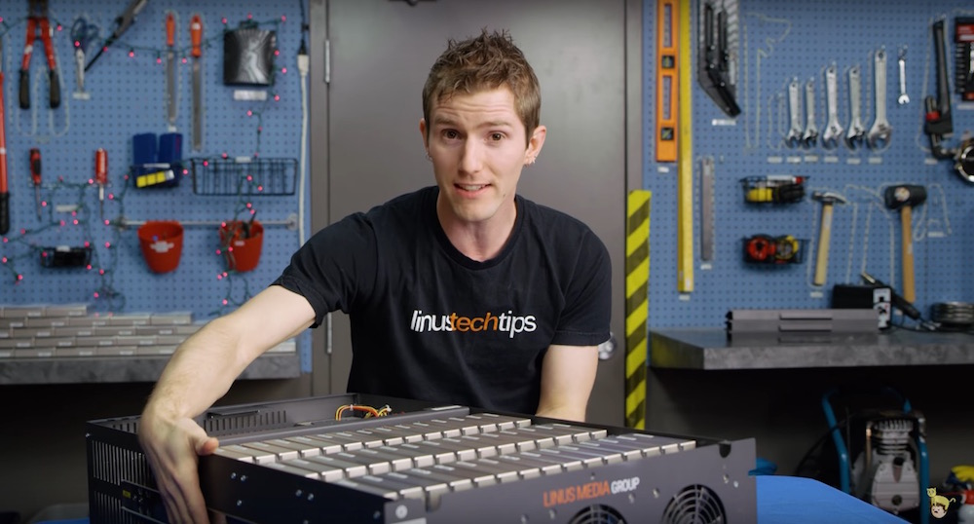
Why going cloud?
Hardware scalability
No longer think about rack space, switches, and power supplies, etc.
Grow storage from GBs to PBs
1PB: one hundred 10TB Enterprise Capacity 3.5 HDD hard drives
https://blog.seagate.com/business/linus-tech-tips-want-petabyte-system/

Slide 15
Why going cloud?
Resource pooling
Enable cost-sharing, a resource to serve different consumers
Resources are dynamically reassigned according to demands
Based on virtualization, running multiple virtual instances on top of a physical computer system
Economy of scale for physical resources
Reliability
Built to handle failures
Fault-tolerant or highly available

Slide 16
Why going cloud?
Worldwide deployment
Deploy applications as close to customers as possible
E.g., to reduce network latency
Improve data locality
Compliant to privacy regulations (e.g., GDPR)
Measured quality of service
Services leverage a quantitative qualitative metering capability making pay-as-you-go (or pay-per-use) billing and validation of the service quality available

Slide 17
Why going cloud?
Service integration
Do not reinvent the wheel, eliminate repetitive tasks
Use services that solve common problems (e.g., load balancing, queuing)
Abstract and automatically adapt the architecture to requirements
E.g., create (test) environments on demand
Integration and abstraction are drivers of change
From databases to data platforms
From on-premises to serverless architectures
From custom to standardized data pipelines

Slide 18
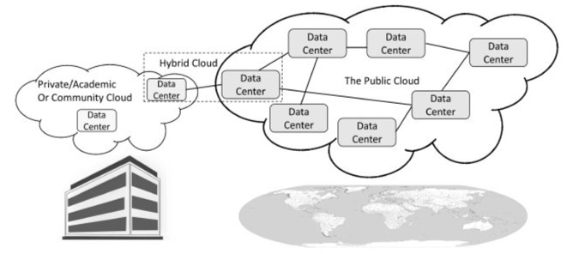
Cloud computing: types of cloud
There are different types of cloud
Public: accessible to anyone willing to pay (e.g., Microsoft, AWS, Google)
Private: accessible by individuals within an institution
In public cloud, any resources that you are not using can be used by other
Users share the costs
Cost-sharing disappears in private clouds
Hybrid: a mix of the previous

Slide 19
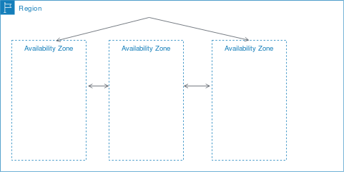
Cloud computing: types of cloud
Cloud services are hosted in separate geographic areas
Locations are composed of regions and availability zones
Region (e.g., us-east-1)
Is an independent geographical area that groups data centers
Has availability zones
Availability zones in a region
A data center
Connected through low-latency links
Resources are usually replicated across zones but not regions
https://docs.aws.amazon.com/AWSEC2/latest/UserGuide/using-regions-availability-zones.html

Slide 20
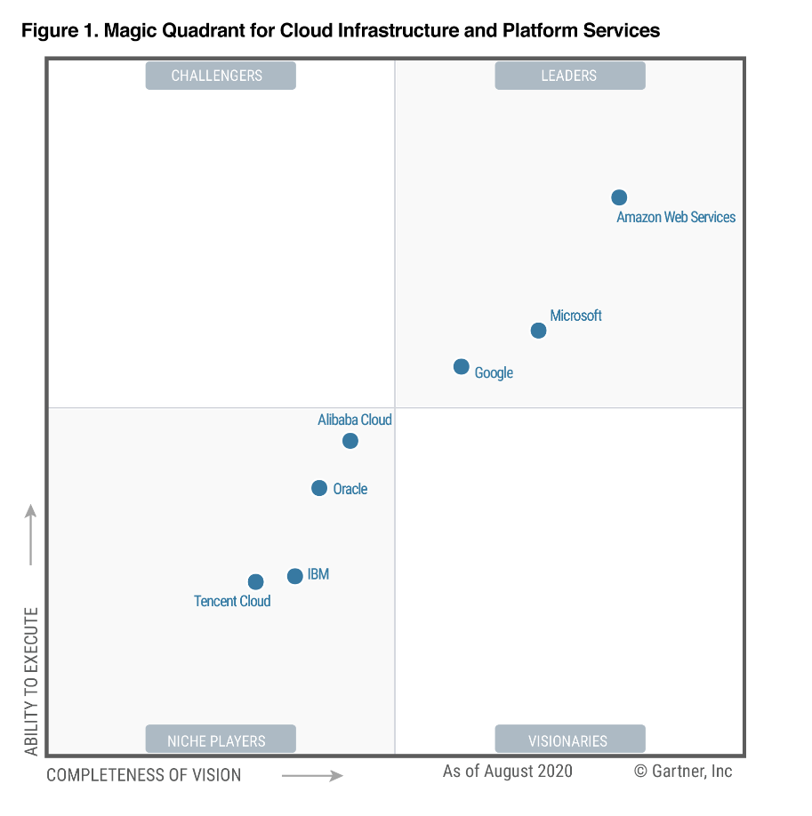
Cloud computing: principal vendors
Gartner Magic Quadrant
Understanding the technology providers to consider for an investment
Leaders execute well and are well positioned for tomorrow
Visionaries understand where the market is going but do not yet execute well
Niche Players focus successfully on a small segment, or are unfocused and do not out-innovate or outperform others
Challengers execute well but do not demonstrate an understanding of market direction
Focusing on leaders isn’t always the best
A niche player may support needs better than a market leader. It depends on how the provider aligns with business goals

Slide 21
Cloud computing: deployment models
On a cloud architecture, you can rely on serverless or managed services
Serverless
Standalone independent services built for a specific purpose and integrated by cloud service provider
No visibility into the machines
There are still servers in serverless, but they are abstracted away
No server management, do not have to manage any servers or scale them
E.g., when you run a query on BigQuery you do not know how many machines were used
Pay for what your application uses, usually per request or per usage
(Fully) Managed
Visibility and control of machines
You can choose the number of machines that are being used to run your application
Do not have to set up any machines, the management and backup are taken care for you
Pay for machine runtime, however long you run the machines and resources that your application uses
https://cloud.google.com/blog/topics/developers-practitioners/serverless-vs-fully-managed-whats-difference (accessed 2020-08-01)

Slide 22
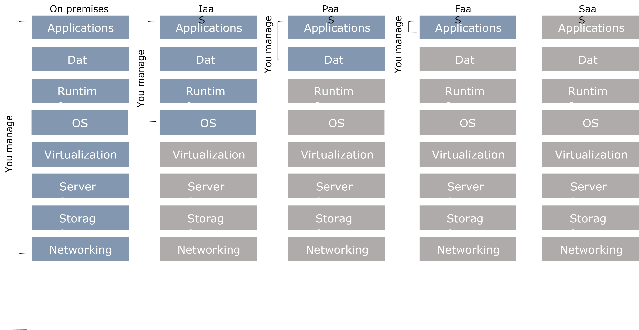
Cloud computing: deployment models
Understanding architectures is paramount to successful systems
Good architectures help to scale
Poor architectures cause issues that necessitate a costly rewrite
XaaS (anything as a service)
A collective term that refers to the delivery of anything as a service
It encompasses the products, tools and technologies that vendors deliver to users

Slide 23
Cloud computing: deployment models
Principles of FaaS architectures
FaaS is based on a serverless approach, use a compute service to execute code on demand
Every function could be considered as a standalone service
Write single-purpose stateless functions
Functions react to events
Design push-based, event-driven pipelines
Create thicker, more powerful front ends
Embrace third-party services (e.g., security)
FaaS is not a silver bullet
Not appropriate for latency-sensitive applications
Strict specific service-level agreements
Migration costs
Vendor lock-in can be an issue

Slide 24
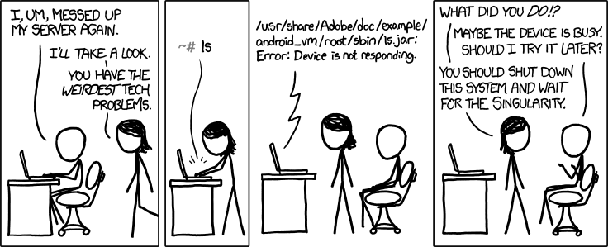
https://xkcd.com/1084/

Slide 25
Cloud in WeLASER

Slide 26
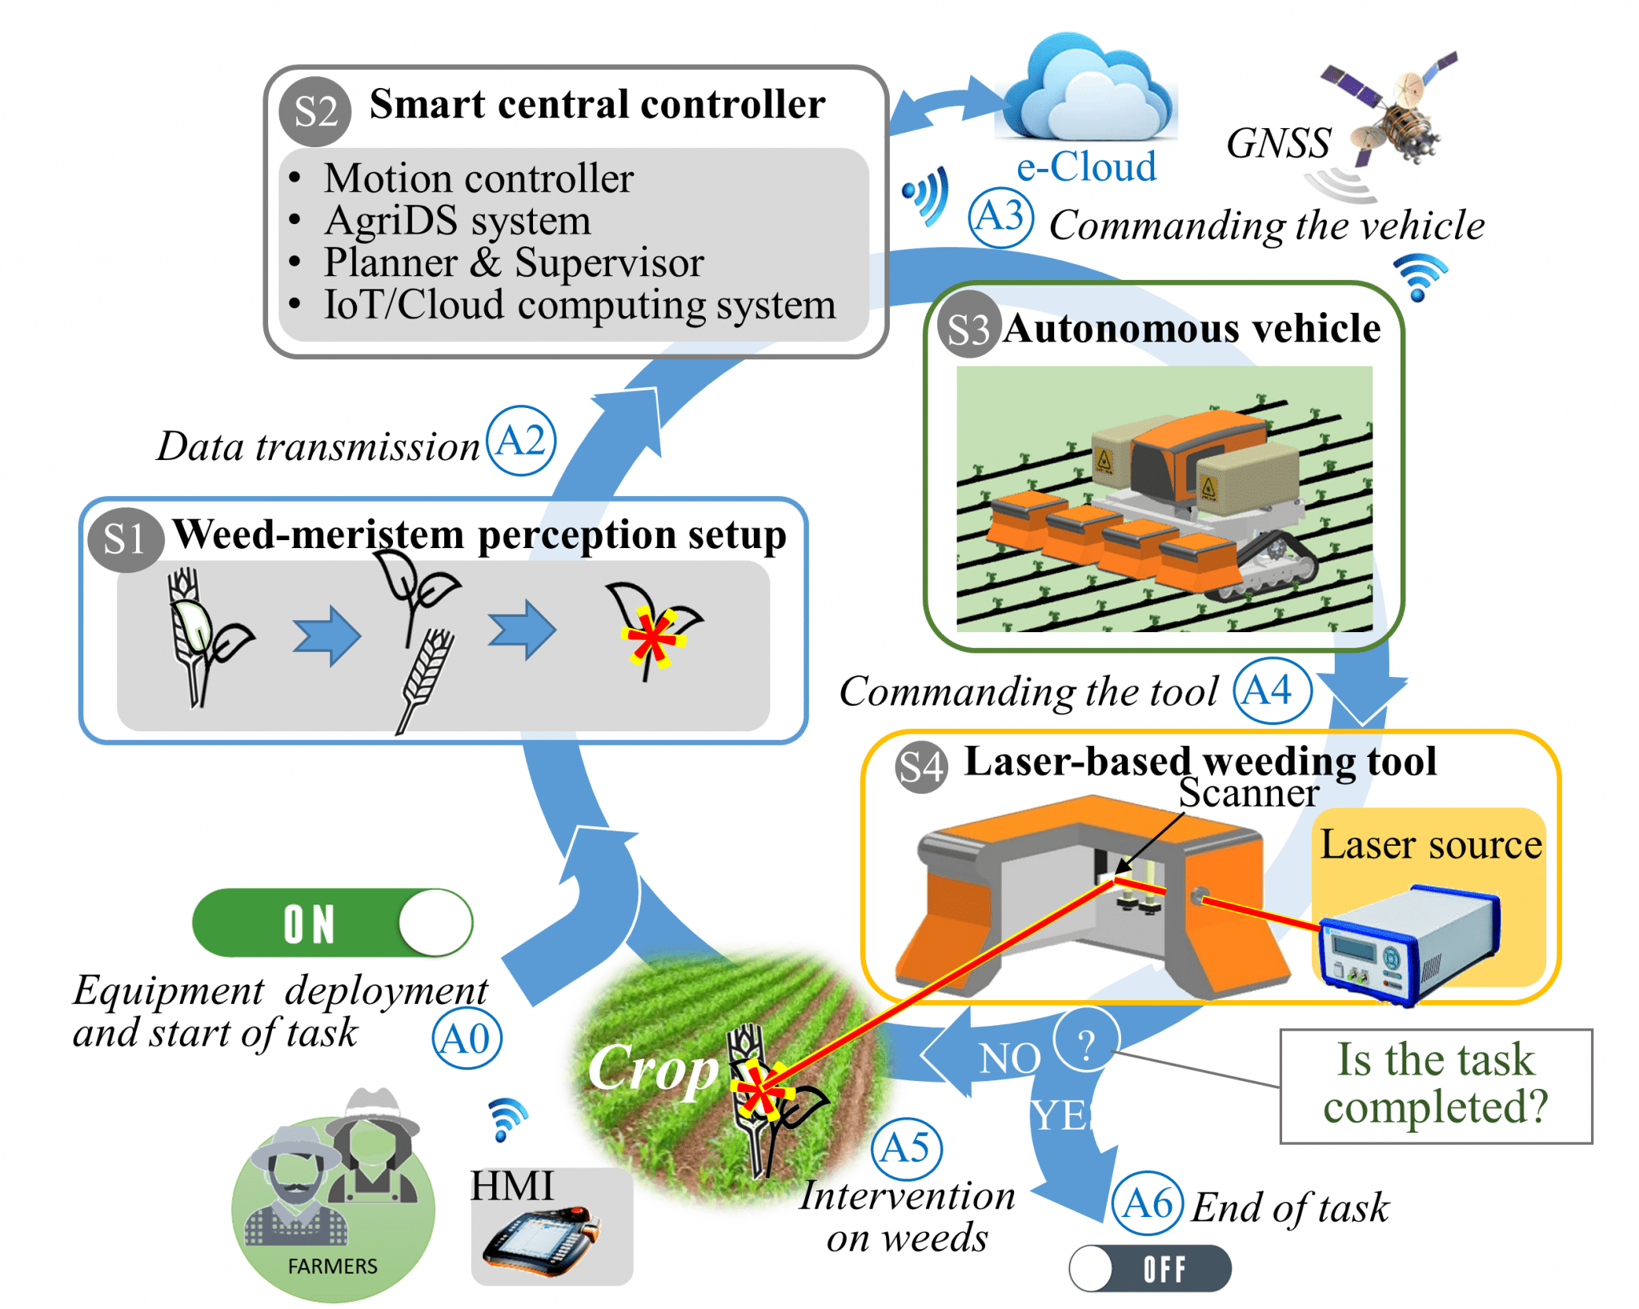
WeLASER
The EU-funded WeLASER project will develop a non-chemical solution for weed management based on pioneering technology consisting of the application of lethal doses of energy on the weed meristems through a high-power laser source. An AI-vision system separates crops from weeds, identifying the weed meristems and pointing the laser at them. A smart controller based on IoT and cloud computing techniques coordinates the system, which is transferred all over the field by an autonomous vehicle.

Slide 27

Network and Data Collection
The architecture entails three networks
A wi-fi mesh necessary for exchanging data between the field nodes
Wi-fi mesh wakes up after receiving events from the e-fence
A wi-fi router on the robot connected to the internet
Always turned on
A SIM card on the HMI

Slide 28
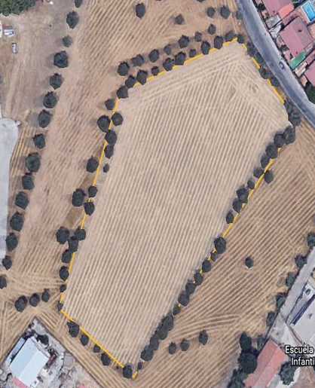





Network and Data Collection
WEATHER STATION
MESH BRIDGE
CAMERA NODE
ROUTER WITH SIM (Internet connection)
HMI
ROBOT
Cloud
Wi-Fi Robot
SIM Card
Wi-Fi Mesh

Slide 29
Requirements
A modular data platform for precision agriculture
Collecting data from heterogeneous sources (e.g., MQTT devices and robots)
Augmenting data with externally available knowledge (e.g., Open Street Map open data)
Maintaining digital twins
Building a unifying data model supporting precision agriculture
Managing meta-data supporting effective data access and management (e.g., access data depending on the geographical location)
Enabling heterogenous data fruition
Querying the collected data through well-known languages and APIs
Dashboards of KPIs
…

Slide 30

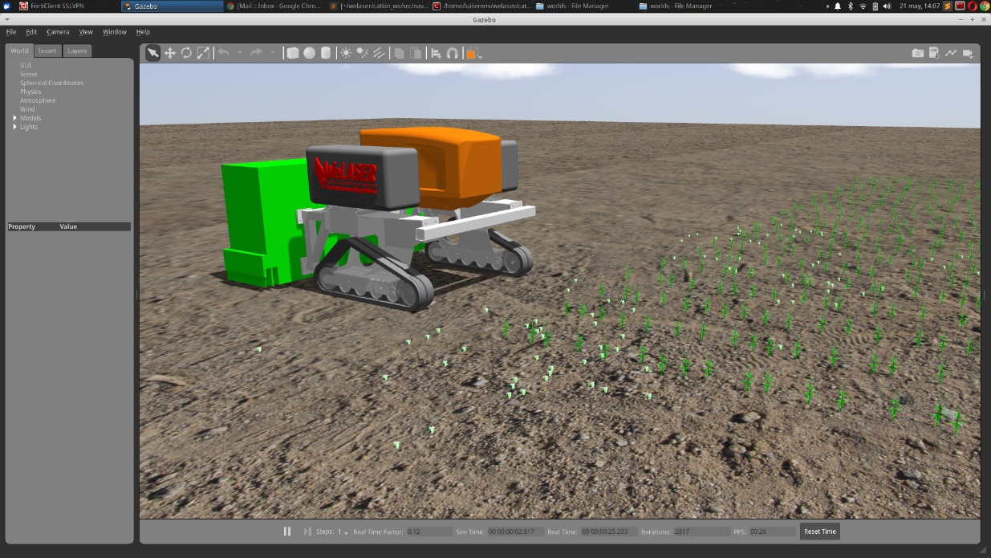
Digital Twins and Simulation

Slide 31
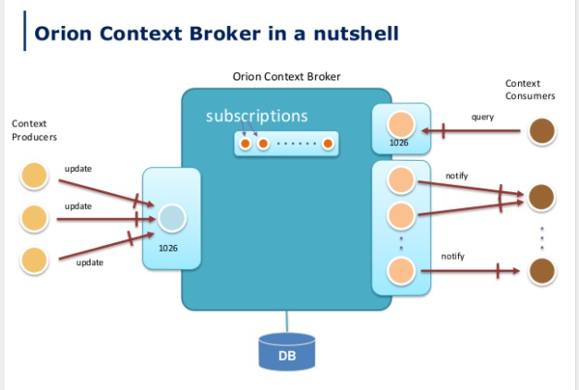
FIWARE
An open-source framework of modular software components
Goal: Developing digital twins and data spaces in several domains
Only mandatory component of any “Powered by FIWARE” platform is the Context Broker
Manage context information
Enabling to perform updates
Bring access to context
Smart Data Model includes three elements:
Schema defining data types and structure
Specification of a written document for human readers
Examples of the payloads

Slide 32
FIWARE
GET /v2/entities/{entityID}/attrs/{attrName}
retrieve an attribute’s data
PUT /v2/entities/{entityID}/attrs/{attrName}
updates an attribute’s data
DELETE /v2/entities/{entityID}/attrs/{attrName}
deletes an attribute
GET /v2/entities/{entityID}/attrs/{attrName}/value
retrieves an attribute’s value
PUT /v2/entities/{entityID}/attrs/{attrName}/value
updates an attribute’s value
GET /v2/entities/{entityID}/attrs/{attrName}
retrieve an attribute’s data
PUT /v2/entities/{entityID}/attrs/{attrName}
updates an attribute’s data
DELETE /v2/entities/{entityID}/attrs/{attrName}
deletes an attribute
GET /v2/entities/{entityID}/attrs/{attrName}/value
retrieves an attribute’s value
PUT /v2/entities/{entityID}/attrs/{attrName}/value
updates an attribute’s value

Slide 33








Innovation: Data Platform for Precision Agriculture
Visual dashboard
A graphical user interface which provides at-a-glance views of key performance indicators (KPIs)
Real-time and historical data
Operator interface = HMI + Controller
HMI
A mobile tablet (e.g., iPad) running a web-based application
As of now, requires internet connection
Controller
A "joystick" used both for safety and remote manual control
PC
Operator Interface
Generic user
(farmer, third party operator, team component, etc.)
HMI
Exploitation
Visual dashboard
Mission planner
Mission supervisor
Event bus (Kafka)
The bus streams the events through all the modules that build up the WeSOM using a publish-and-subscribe model
FIWARE Orion Context Broker
Orion Context Broker implements the FIWARE NGSI version 2 API.
Management
IoT Agent
Translates the native protocol of the attached devices so that they can dialog to the Orion Context Broker that accepts NGSI requests only.
FIROS
MQTT Broker
Robot simulator
(ROS)
Ingestion
Devices
Keeping the MQTT Broker on the edge enables sensor-to-sensor communication without cloud delays

Slide 34
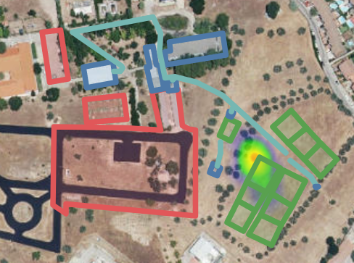
Smart Data Models
Example of FIWARE entity and Weeding Heatmap {
"type": "Device", "name": “Laser-123",
"id": "urn:ngsi-ld:Device:Laser123",
"areaServed": "urn:ngsi-ld:AgriFarm:123",
"location": { "type": "Point", "coordinates": [-3.481, 40.312 ] },
"timestamp": “2023-04-10T08:30:59”
"controlledProperty": [ “detectedWeeds”, “treatedWeeds” ],
"value": [ 123, 100 ]
}

Slide 35
Smart Data Models
Many smart data models from the FIWARE ecosystem exist
E.g., AgriFood, Robotics, SmartCities
DMs are overlapping and sometimes inconsistent between each other
E.g., AgriOperation and BuildingOperations have different semantics
DMs are good for representing data, but «bad» for analytics
Create a unifying meta-model to integrate them
AgriFood
SmartCities
Robotics

Slide 36
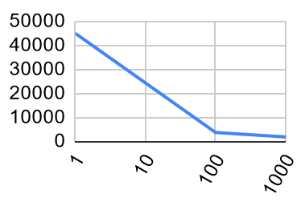
Cloud and Economy of Scale
Cloud costs (on AWS) per 1/100/1000 licenses
Hardware
Computing:
Fixed: machines that must always be up and running
Spot: machines that are turned only when concurrent missions are running
Storage:
MongoDB: data from FIWARE Context Broker (i.e., current context) and historic data
S3: raw mission images
No HDFS: more expensive than switching to S3 unless HW for storage is already available
People (8h/day): customer care (answering tickets) + developers (maintenance)
Software: cost of the single software license
Cost type | #Licenses | 1 | 100 | 1000
Hardware | Computing (Fixed + Spot) | 3 000€ | 15 000€ | 120 000€
 | Storage (MongoDB + S3) | 1 000€ | 15 000€ | 130 000€
People | Customer care | 0€ | 120 000€ (3 people) | 400 000€ (10 people)
 | Developer | 40 000€ (1person) | 120 000€ (3 people) | 200 000€ (5 people)
Software | License | 1 000€ | 100 000€ | 1 000 000€
 | Total cost | 45 000€ | 370 000€ | 1 850 000€
 | Per license cost | 45 000€ | 3 700€ | 1 850€

Slide 37
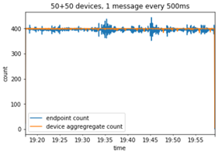
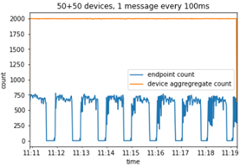
Performance
Experimental evaluation
We implemented a FIWARE architecture to get practiced with it and to stess it performances and limitations
We handled up to 600 messages per second
200 entities, 1 message every 500ms
200 entities, 1 message every 100ms

Slide 38
References
Vitali, G, et al. "Crop management with the IoT: An interdisciplinary survey." Agronomy (2021)
Francia, M., et al. "Making data platforms smarter with MOSES." Future Generation Computer Systems (2021)
Francia, M., et al. "Multi-sensor profiling for precision soil-moisture monitoring.“ Computers and Electronics in Agriculture (2022)
Emmi, L., et al. "Exploiting the Internet Resources for Autonomous Robots in Agriculture." Agriculture (2023)

